Slide 1
Programming Refresher
Notes:
Let's start with a quick refresher on Python programming basics.

Slide 2
Python Functions
Notes:
Let's dive into defining and using functions in Python

Slide 3
Create and use functions in Python to improve code organization and reusability
Identify the advantages of using functions in programming to improve modularity, simplify debugging, and enhance collaboration
Construct a Python function with different types of arguments to enhance code modularity and flexibility
Analyze the scope of variables within functions to manage variable accessibility and duration effectively
Utilize Python generators for efficient data handling to optimize memory usage and performance
Notes:
Read the learning objectives​

Slide 4
Business Scenario
ABC is a fintech company that onboards merchants for its payment gateway. Each new merchant requires a customized backend class, leading to separate codes for each module. This process is inefficient and time-consuming.
By combining repetitive tasks into functions, the same code can be reused across different merchant modules, improving efficiency.
To achieve this, the organization will explore functions, variables, and their scope.
Notes:
Elaborate on the business scenarios and discussion in the class​

Slide 5
Python Functions and Their Advantages
Notes:
Let's understand the benefits and applications of functions in Python.

Slide 6
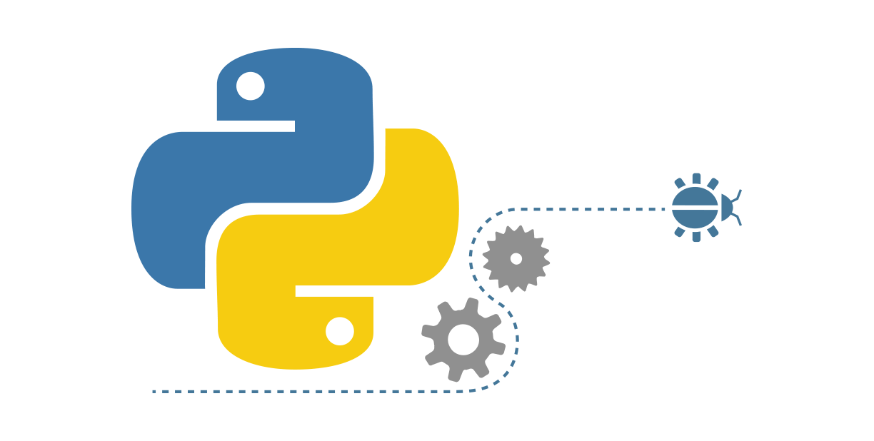
Introduction to Python Functions
A function is a collection of related statements that accomplish a specific task.
It is an organized block of reusable code.
It executes only when it is called.
Parameters are data passed into a function.
Notes:
Functions are the primary and the most important method of code organization and reuse in Python.
Each function can have some number of positional arguments and some number of keyword arguments.

Slide 7
Functions: Advantages
1
Enables comprehensibility
Supports modularity
2
3
Enhances program quality
Promotes reusability
4
5
Improves scalability
6
Provides ease of use
Notes:
This slide is self explanatory.

Slide 8
Functions: Syntax
The basic syntax of a function in Python consists of two parts:
Function definition
A function is defined using the keyword def, followed by a function name and parenthesis.
The argument names passed to the function are mentioned inside this parenthesis.
The body of the function is an indented block of code.
01
Syntax
def myFunction(arg1, arg2):
body
Notes:
A function is usually created using the keyword ‘def’.
The outcome of a function is transmitted via a return statement, which is one of the essential features of a function. Arguments in parenthesis are basically assignments.

Slide 9
Functions: Syntax
The basic syntax of a function in Python consists of two parts:
Function call
A function can be called from anywhere in the program.
When a function is called, program control is transferred to the called function to perform the defined task.
All the necessary parameters and arguments should be passed during the function call.
02
Syntax
myFunction(arg1, arg2)
Notes:
In Python, a function call is a way to execute a function and perform a specific task or operation. When you call a function, you provide the necessary arguments (if any) and the function's code is executed.

Slide 10
Function Arguments
Notes:
Let's learn about function arguments and how they are used to pass data into functions in Python

Slide 11
Functions Arguments
Function arguments are values passed to a function as inputs for performing operations.
The features of the arguments are as follows:
Information can be passed to a function in the form of arguments.
A function may have zero to multiple arguments separated by commas.
Plan
Features
The arguments are specified and enclosed in parentheses in the function definition immediately after the function name.
The arguments can be data values, objects, or functions.
Notes:
This slide is self explanatory.

Slide 12
Functions: Argument Matching
Arguments in Python can be matched by position or name.
Positional arguments must be in the same order as in the function definition.
Keyword arguments are referenced by name and may be in any order.
Positional and keyword arguments can be mixed in a function call.
Note
Arguments in a function may also be defined with a default value.
Notes:
Positional arguments must be provided in the same order as defined in the function's parameter list.
Keyword arguments are referenced by name and can be provided in any order.

Slide 13
Assisted Practice: Function and Argument Matching
Duration: 5 mins
Objective: In this demonstration, you will learn to create a function with arguments.
Steps to perform:
Step 1: Create a function
Step 2: Pass arguments to the function
Step 3: Perform argument matching
Step 4: Call the function and display the results
Note
Please refer to the Reference Material section to download the Jupyter Notebook files for the mentioned topic.
Notes:
Trainer Notes:
Perform each step along with the learner.

Slide 14
Functions: Arbitrary Arguments
Python allows passing variables with multiple arguments using special symbols.
The symbols used to pass arguments are:
*args
Non-keyword arguments
**kwargs
Keyword arguments
Note
These notations are used when the number of arguments to be passed to the function is uncertain.
Notes:
This slide is self explanatory.

Slide 15
Functions: Arbitrary Arguments
The types of arbitrary arguments are explained below:
Non-keyword arguments | Keyword arguments
The symbol * captures a variable number of arguments. | Keyword arguments use the ** symbol. Conventionally, kwargs defines keyword arguments.
Conventionally, args defines non-keyword arguments. | A keyword argument allows you to name the variable before passing it to the function.
he function unpacks these arguments as a list. | Keyword arguments function like a dictionary, mapping each value to its keyword.
Notes:
This slide is self explanatory.

Slide 16
Assisted Practice: Arbitrary Arguments
Duration: 5 mins
Objective: In this demonstration, you will learn to use arbitrary arguments.
Steps to perform:
Step 1: Define a function that takes arbitrary arguments
Step 2: Pass arguments to the function
Step 3: Call the function and display the results
Note
Please refer to the Reference Material section to download the Jupyter Notebook files for the mentioned topic.
Notes:
Trainer Notes:
Perform each step along with the learner.

Slide 17
return Statement
Notes:
Let's understand how the return statement is used to send a result back from a function

Slide 18
Functions: return Statement
The return keyword passes values back to the function call.
If the return statement is not used, Python returns None by default.
After the return statement is executed, no further statements of the function are executed.
A function can return none, multiple values, or data objects.
Notes:
This slide is self explanatory.

Slide 19
Assisted Practice: return Statement
Duration: 5 mins
Objective: In this demonstration, you will learn to use the return statement.
Steps to perform:
Step 1: Define a function with arguments
Step 2: Use the return statement to return values when the function is called
Step 3: Call the function and display the results
Note
Please refer to the Reference Material section to download the Jupyter Notebook files for the mentioned topic.
Notes:
Trainer Notes:
Perform each step along with the learner.

Slide 20
Scope of a Variable
Notes:
Let's understand the scope of a variable in Python.

Slide 21
Function: Scope
Scope in programming defines the environment where the variables can be accessed and referenced.
Features
If a value of a variable is to be retrieved in a function, it searches for the global environment of each package on the search list.
It defines the functional range of any variable or function.
Notes:
Variables have a specific scope that determines where they can be accessed and used. The scope is usually defined by the block of code in which the variable is declared or defined.

Slide 22
Function: Scope
There are two types of scope:
Global scope | Local scope
Variables and functions defined outside of all classes and functions have global scope. | Variables or functions defined inside a function block, including argument names, are local variables.
It allows variable values to be used or functions to be called from anywhere in the file in the program. | It can be accessed only inside the function block.
Notes:
This slide is self explanatory.

Slide 23
Assisted Practice: Scope of Variables
Duration: 5 mins
Objective: In this demonstration, you will learn about the scope of variables.
Steps to perform:
Step 1: Define and demonstrate a global variable
Step 2: Define and demonstrate local variables inside a function
Step 3: Modify global variables inside a function using the global keyword
Note
Please refer to the Reference Material section to download the Jupyter Notebook files for the mentioned topic.
Notes:
Trainer Notes:
Perform each step along with the learner.

Slide 24
Generators Function
Notes:
Let's investigate how generator functions work in Python

Slide 25
Function: Generators
Generators are a special function supported in Python that returns an iterator object with a sequence of values.
A generator uses a yield statement instead of a return statement.
Features
A generator object can be iterated only once.
A function with a yield statement is termed a generator.
Notes:
In Python, a generator is a special type of function that generates a sequence of values, one at a time, instead of returning a single value like a regular function. It allows you to create iterators in a more concise and memory-efficient way.

Slide 26
return vs. yield Statement
The differences between the return and yield statements are given below:
return statement
yield statement
The return statement implies that the function is returning control of execution to the point from where the function is called.
The process destroys the local variables and values generated.
The yield statement implies that the transfer of control is temporary.
It does not destroy the states of the function’s local variables.
Notes:
The return statement is used in regular functions to provide a final result and terminate the function.
The yield statement is used in generator functions to produce a sequence of values and allows the function's execution to be paused and resumed.

Slide 27
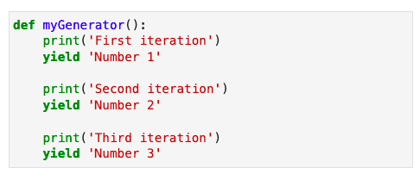
Generator: Example
Here a generator function is defined that yields three values:
Note
In place of multiple yield statements, a loop can also be used inside the function to generate the values.
Notes:
This slide is self explanatory.

Slide 28
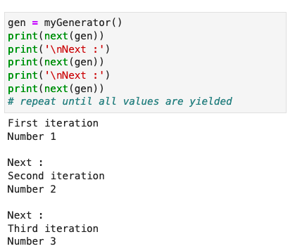
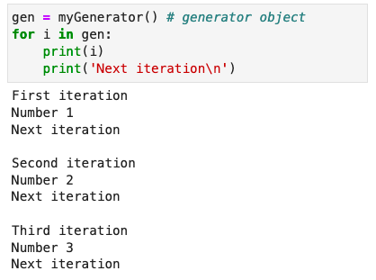
Ways to Use a Generator
The generator function can be used in two ways:
It can be used with the built-in next function.
It can be used with a for loop as an iteration object.
Notes:
This slide is self explanatory.

Slide 29
Lambda Functions
Notes:
Let's learn how to use lambda functions in Python.

Slide 30
Lambda Functions
Python lambda functions are anonymous functions defined using the keyword lambda.
A lambda function may have any number of arguments but contains only one expression.
Features:
The lambda functions are syntactically restricted to only a single expression, which is evaluated and returned.
A lambda function can be defined without assigning a variable or explicitly calling it.
Syntax: lambda arguments: expression
Notes:
Python lambda functions are anonymous functions defined using the lambda keyword. They are used for small and simple operations and can be defined inline without a formal function name.

Slide 31
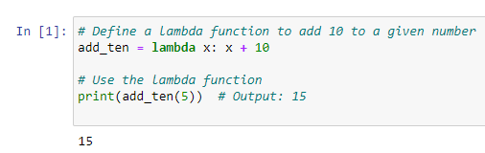
Lambda Function: Example
This example demonstrates how to use a lambda function in Python to add 10 to a given number:
Notes:
add_ten = lambda x: x + 10: This line defines a lambda function that takes one argument x and returns x + 10.
print(add_ten(5)): This line calls the lambda function with the argument 5. The function adds 10 to 5 and returns 15, which is then printed.

Slide 32
Function Types
Notes:
Let's understand the different types of functions in Python

Slide 33
Types of Functions
Functions can be of two types:
Built-in functions | User-defined functions
Built-in functions are predefined functions in the programming framework. | Python supports the creation of customized, user-defined functions to perform specific tasks.
Python has basic built-in functions, such as len(), sum(), type(), slice(), next(), help(), and format(). | A user can give any function a name with any number of arguments.
Notes:
Built-in Functions: Pre-defined functions in Python like print(), len(), and type().
User-Defined Functions: Functions created by the programmer using the def keyword.

Slide 34
Functional Programming Implementation
Notes:
Let's learn how to implement functional programming in Python

Slide 35
Functional Programming Methods
These built-in functions facilitate functional programming in Python, which uses methods to define computations.
Filter function
Syntax: filter(func, iterable)
Map function
Syntax: map(func, iterable)
Reduce function
Syntax: reduce(func, iterable)
Types
The map and filter functions are basic built-in functions, whereas the reduce function is part of a module named _functools.
Notes:
The map() and filter() functions are basic built-in functions in Python that are commonly used for data manipulation and transformation.

Slide 36
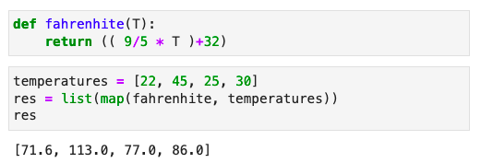
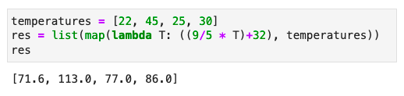
map()
A map function can apply a function to each element of an iteration object.
Example
The map function takes two arguments: a function and an iterable object.
It applies the given function to all elements of the given iteration object.
It generates an iterator, which can be converted to a list.
It can also use the lambda function for implementation.
Notes:
This slide is self explanatory.

Slide 37
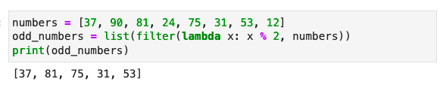
filter()
A filter function filters data based on a condition defined in the function.
Example
The filter function also takes a function and an iterable object and applies the function to each element of the iteration object.
The given function should return a Boolean value.
Notes:
This slide is self explanatory.

Slide 38
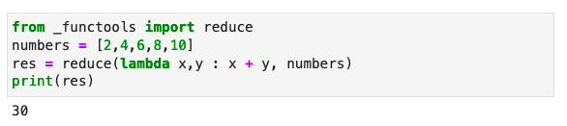
reduce()
A reduce function implements the mathematical technique of folding on an iteration object.
Example
The reduce function uses a given function to process an iterable object.
The reduce function applies the function continually to each element of the iterable object and produces a single cumulative value.
Notes:
This slide is self explanatory.

Slide 39
Assisted Practice: Generators, Lambda, and Built-in Functions
Duration: 10 mins
Objective: In this demonstration, you will learn to use the generators, lambda, and built-in functions
Steps to perform:
Step 1: Define a generator function that yields values one by one
Step 2: Introduce the lambda function and use it with built-in functions
Step 3: Apply built-in functions like map(), filter(), or reduce() to process lists efficiently
Note
Please refer to the Reference Material section to download the Jupyter Notebook files for the mentioned topic.
Notes:
Trainer Notes:
Perform each step along with the learner.

Slide 40
Functions are an important structure of any programming language to create a modular and reusable application.​
Python functions use the def keyword to define functions, can take 0 or more arguments, and can return a value or None.​
Variables declared in the function have a local scope, and variables declared outside a function have a global scope.​
Iterators are a way to traverse over a string, list, or tuple, and they exhibit the concept of generators.​
The Lambda keyword defines an anonymous function in Python. ​
Notes:
Read the key takeaways

Slide 42
The advantages of functions are:​
1
Reusability​
Ease of use​
Scalability​
All of the above​

Slide 43
The advantages of functions are:​
1
Reusability
Ease of use​
Scalability​
All of the above​
D
Functions are reused, easy to access, and scalable.​

Slide 44
Information can be passed to a function in the form of _______.​
2
Arguments​
Names
Tasks​
All of the above​

Slide 45
Information can be passed to a function in the form of _______.​
2
Arguments​
Names
Tasks
All of the above​
A
Information can be passed to a function in the form of arguments or parameters.​

Slide 46
A function is defined using the keyword _____.​
3
func
function
def​
All of the above​

Slide 47
A function is defined using the keyword _____.​
3
func
function​
def
All of the above​
C
A function is defined using the keyword def, followed by a function name and parenthesis.​

Slide 48
Thank You!
Notes:
Thank you

